Slide 1
Data Encryption Standard
Stream Ciphers, Block Ciphers, Feistal Cipher

Slide 2
Stream Ciphers
A stream cipher is one that encrypts a digital data stream one bit or one byte at a time
The bit-stream must be generated algorithmically
The algorithms works with a common key
As long as the key is unique and random, stream ciphers are unbreakable
Vignere and Vernam ciphers are examples of Stream Ciphers

Slide 3
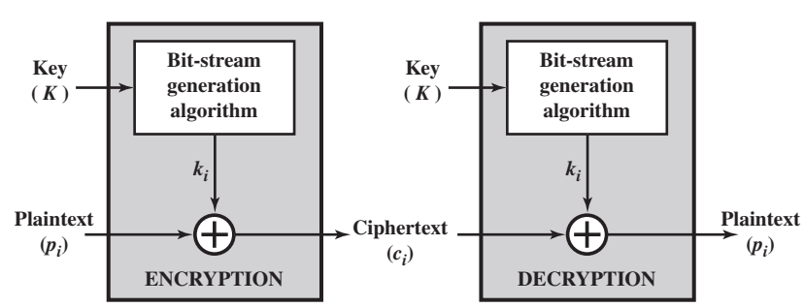
Stream Cipher Model

Slide 4
Block Ciphers
A block cipher is one in which a block of plaintext is treated as a whole and used to produce a ciphertext block of equal length
A block size of 64 or 128 bits is used
Using Block Cipher Modes of Operation a block cipher can be as strong as a Stream Cipher
Block Ciphers are applicable to a broader range of applications than stream ciphers

Slide 5
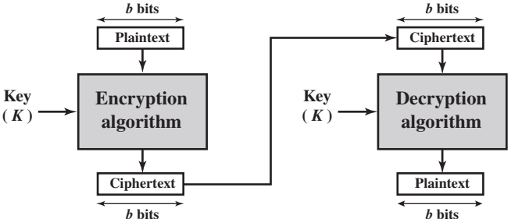
Block Cipher Model

Slide 6
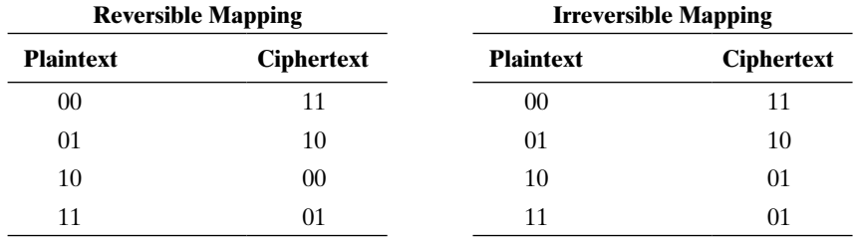
Motivation for Feistal Cipher
For a block of length n, 2^{n} possible plaintexts can be seen

Slide 7
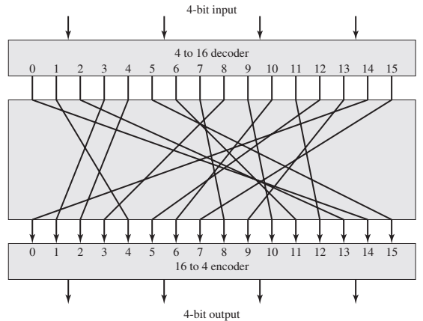
4 to 16 bit encoder-decoder

Slide 8
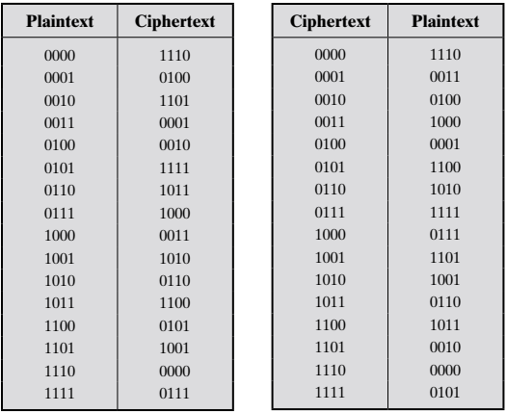
Encryption and Decryption Tables

Slide 9
The mappings are similar to substitution ciphers
That leaves a possibility of cryptanalysis attack
The cryptanalysis can be prevented with large block sizes
The substitution must be arbitrarily reverse

Slide 10
But arbitrary reversible and large block size together are impractical to achieve
Why?

Slide 11
key length = n x 2^{n}
= 4 x 2⁴
= 64 bits
where n is the length of the block
If block length is 64, then key length will be
64 x 2⁶⁴ = 10²¹ bits

Slide 12
Conclusions
If the block size is small, attacks are easy
But if we increase block size, key size increases in the order of nx2^{n}
Key size must be as minimal as possible for performance
Block Ciphers are substitution Ciphers
Some substitutions are irreversible
We want only reversible substitutions

Slide 13
So, Feistal came to a conclusion that we need to have a key of length k, block size n, and a total of only 2^{k} possible transformations
Substitution - Each plaintext element or group of elements is uniquely replaced by a corresponding ciphertext element or group of elements.
Permutation - A sequence of plaintext elements is replaced by a permutation of that sequence. That is, no elements are added or deleted or replaced in the sequence, rather the order in which the elements appear in the sequence is changed.

Slide 14

Claude Shannon’s Principles
Diffusion
Example
we will attack Lahore at seven pm
ASHALKDGAFFSJSKSLLALLSHDGAS
we will attack Lahore at seven am
QYWIITTEPOOUEUTEITRETEUEU

Slide 15
Confusion – To make the relation between statistics of the ciphertext and value of the key as complex as possible

Slide 16
Parameters of Feistal Cipher
Block Size
Key Size
Rounds
Sub Key Generation Algorithm
Round Function

Slide 17
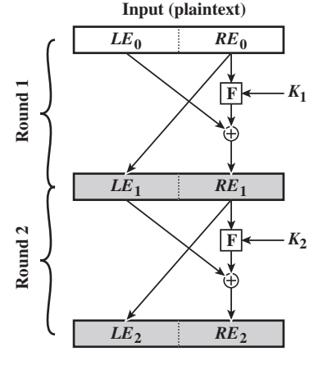
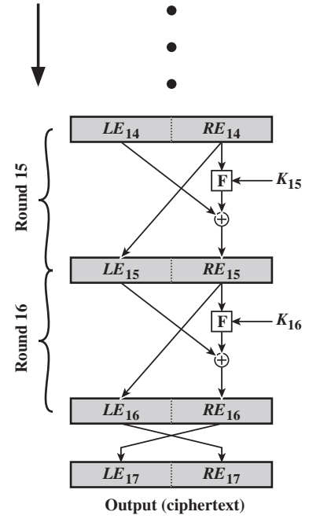
The Feistal Cipher

Slide 18
Data Encryption Standard
Introduced in 1977
Most widely accepted algorithm for commercial applications
Eventually replaced by Triple-DES

Slide 19
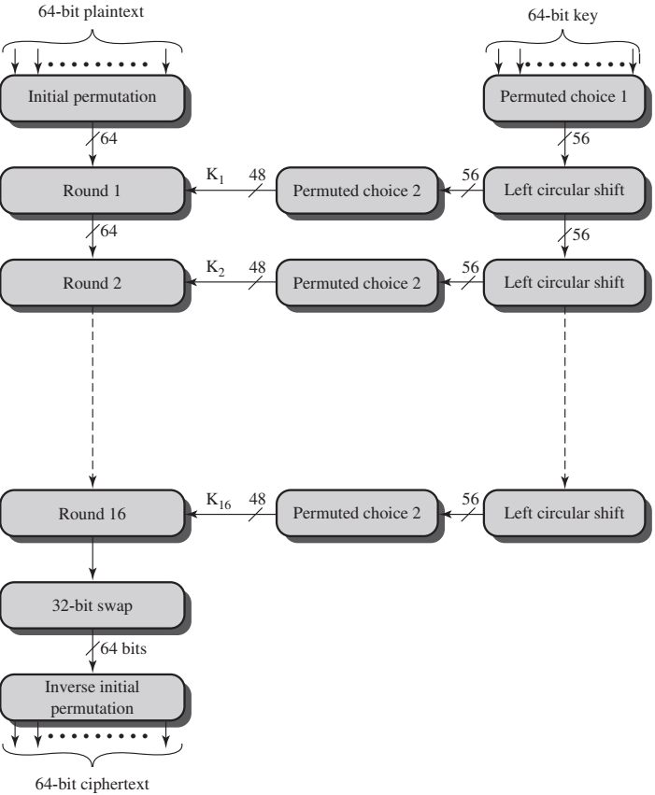

Slide 20
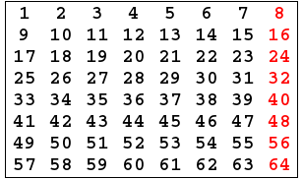
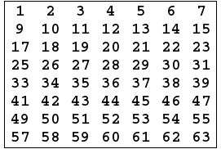
Key processing
Original 64 bit Key
After removing parity bits

Slide 21
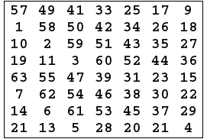
Permutation Choice - 1
This table specifies the input permutation on a 64-bit block. The meaning is as follows: the first bit of the output is taken from the 57th bit of the input; the second bit from the 49th bit, and so on, with the last bit of the output taken from the 4th bit of the input.

Slide 22
K = 00010011 00110100 01010111 01111001 10011011 10111100 11011111 11110001
K+ = 1111000 0110011 0010101 0101111 0101010 1011001 1001111 0001111
C₀ = 1111000 0110011 0010101 0101111
D₀ = 0101010 1011001 1001111 0001111
reduced to 56 bits
split it into two equal halves

Slide 23
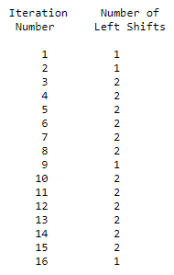
C₀ = 1111000011001100101010101111
D₀ = 0101010101100110011110001111
C₁ = 1110000110011001010101011111
D₁ = 1010101011001100111100011110
C₂ = 1100001100110010101010111111
D₂ = 0101010110011001111000111101
C₃ = 0000110011001010101011111111
D₃ = 0101011001100111100011110101

Slide 24
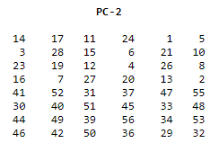
Permutation Choice - 2
C₁D₁ = 1110000 1100110 0101010 1011111 1010101 0110011 0011110 0011110
K₁ = 000110 110000 001011 101111 111111 000111 000001 110010

Slide 25
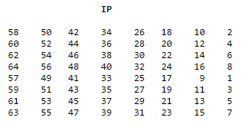
Plaintext Processing
M = 0000 0001 0010 0011 0100 0101 0110 0111 1000 1001 1010 1011 1100 1101 1110 1111
IP = 1100 1100 0000 0000 1100 1100 1111 1111 1111 0000 1010 1010 1111 0000 1010 1010
Here the 58th bit of M is "1", which becomes the first bit of IP. The 50th bit of M is "1", which becomes the second bit of IP. The 7th bit of M is "0", which becomes the last bit of IP.

Slide 26
L₀ = 1100 1100 0000 0000 1100 1100 1111 1111
R₀ = 1111 0000 1010 1010 1111 0000 1010 1010
L_{n} = R_{n-1}
R_{n} = L_{n-1} + f(R_{n-1},K_{n})

Slide 27
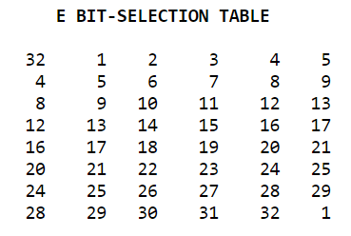
Expansion
first we need to expand the bits
the first three bits of E(R_{n-1}) are the bits in positions 32, 1 and 2 of R_{n-1} while the last 2 bits of E(R_{n-1}) are the bits in positions 32 and 1.
We calculate E(R₀) from R₀ as follows:
R₀ = 1111 0000 1010 1010 1111 0000 1010 1010
E(R₀) = 011110 100001 010101 010101 011110 100001 010101 010101

Slide 28
How f works?
Next in the f calculation, we XOR the output E(R_{n-1}) with the key K_{n}:
K_{n} + E(R_{n-1}).
Example: For K₁ , E(R₀), we have
K₁ = 000110 110000 001011 101111 111111 000111 000001 110010
E(R₀) = 011110 100001 010101 010101 011110 100001 010101 010101
K₁+E(R₀) = 011000 010001 011110 111010 100001 100110 010100 100111.

Slide 29
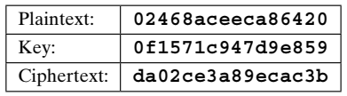
The Avalanche Effect

Slide 30
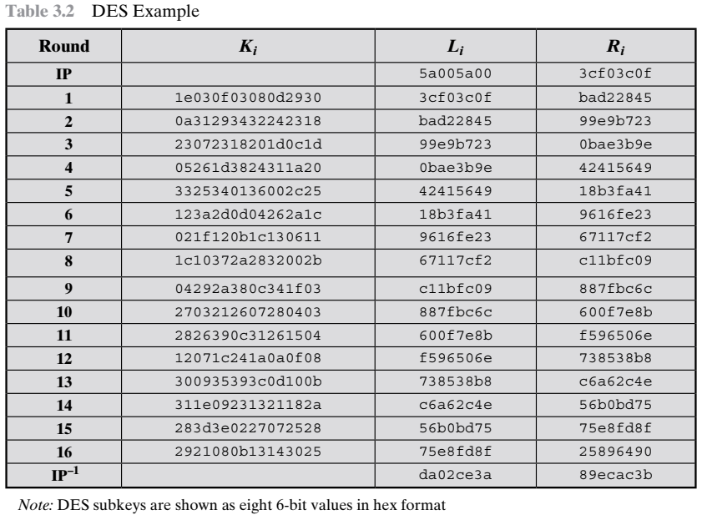

Slide 31
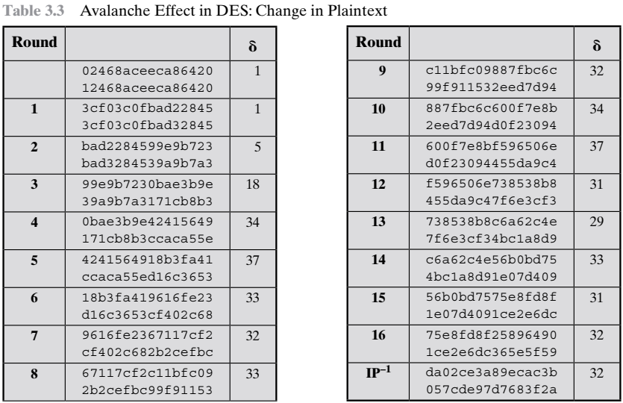

Slide 32
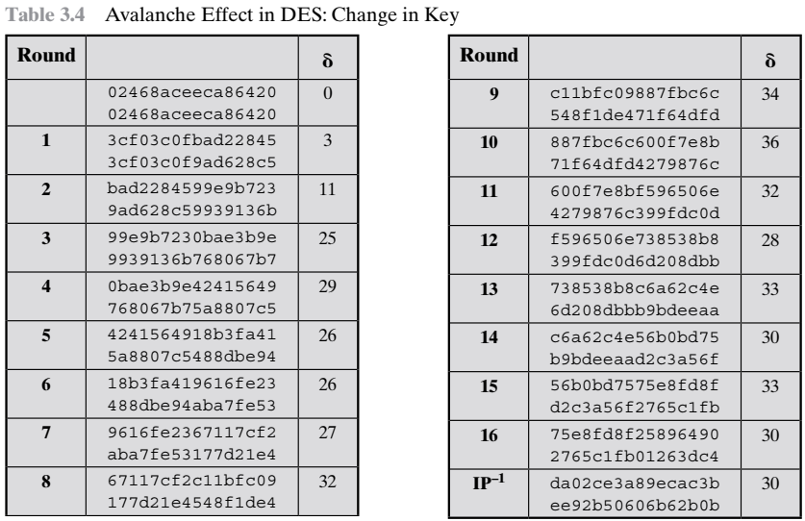

Slide 33
How strong is DES?
When a 56 bit key is used, 2⁵⁶ ~ 7.2 x 10¹⁶ keys are possible.
If a brute-force attack is tried, with one encryption per microsecond, it will take more than 1000 years to search half of key space
But Diffie-Hellman proposed a parallel computing array of devices that can break the cipher in 10 hours

Slide 34
But super computers these days can do 10¹³ decryptions per second, breaking the cipher in an hour
But with key size 128, it would take 1,00,000 years for any computer to brute-force the cipher

Slide 35
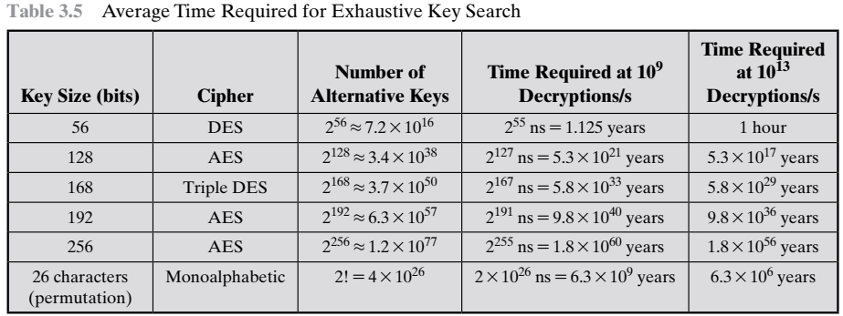
Key Sizes Vs Brute-force attacks

Slide 36
Cryptanalysis on DES
cryptanalysts may try to break the cipher understanding the nature of DES
A point of study for attackers is the concept of S-Boxes or Substitution tables
S-Boxes are the defense against cryptanalysis causing Confusion

Slide 37
S-Boxes are responsible for obscuring the relation between ciphertext and the key
There are eight S-Boxes used in DES, each takes a 6 bit input and produces 4 bit output

Slide 38
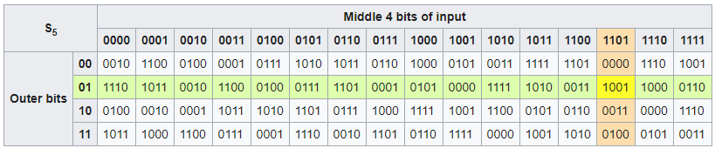
How it works?
input = 011011
outer bits = 01
inner bits = 1101

Slide 39
Are they safe?
There are cases where S-Boxes have exhibited irregularities and unexpected behaviors
But no one successfully claimed till this date that they are able break DES using the flawed S-Box designs

